Slide 1
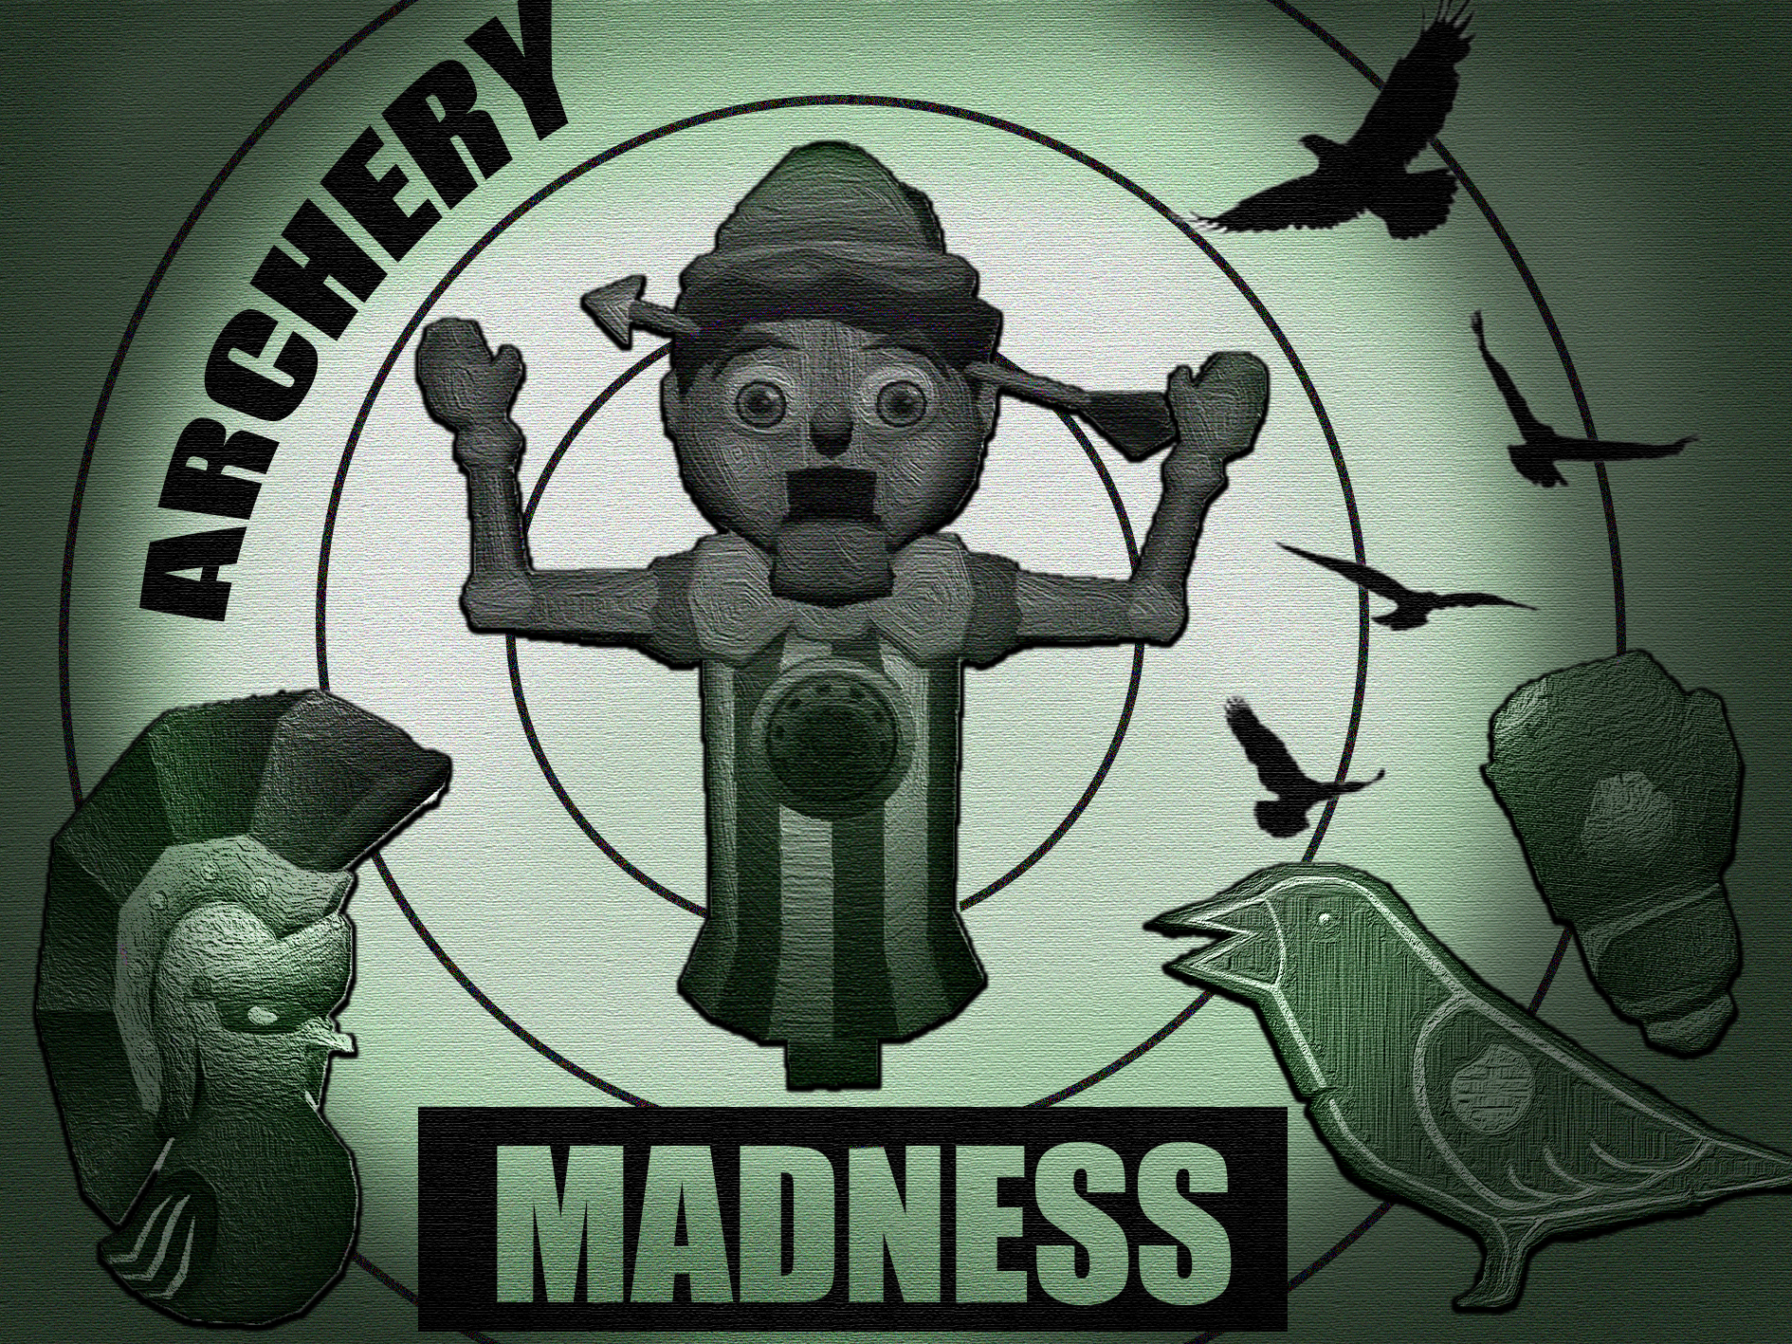
Archery Madness

Slide 2
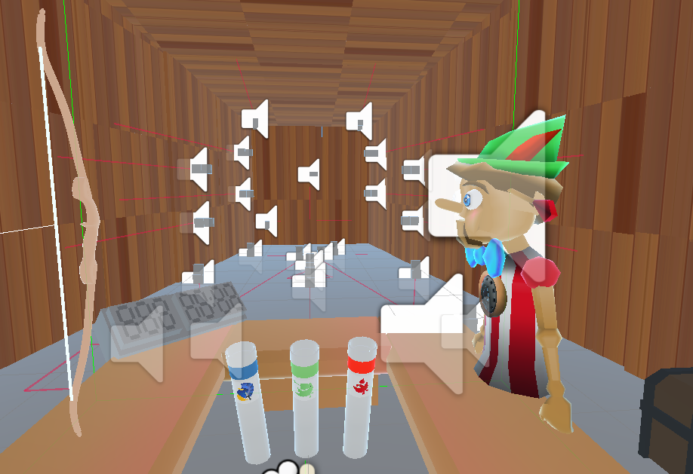
Archery Madness Wireframe
Target Boxes that move around the scene
Bow the player uses.
Barker that gives audio feedback to the player.
Score and Time displays
Quivers that spawn the arrows.

